Slide 1

Used Cars Web scrapping and Model Building
~ Sudha Udayakumar

Slide 2

EDA from Python & Tableau

Slide 3
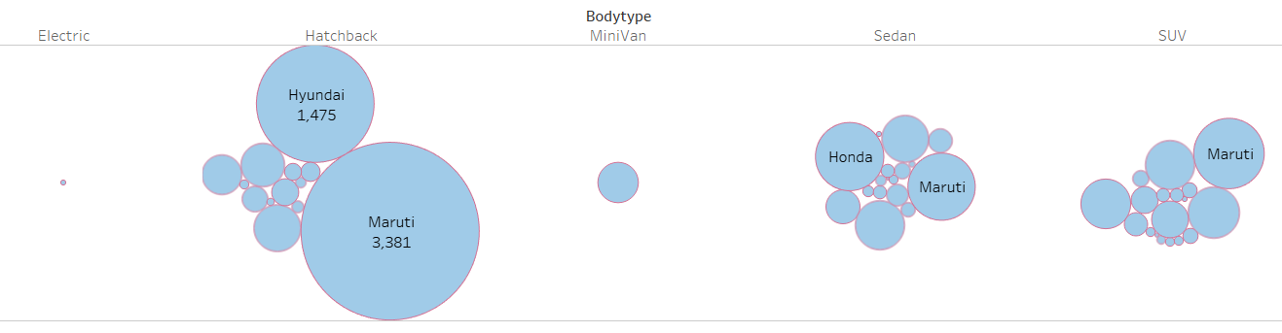
Car Brand & Body Type

Slide 4
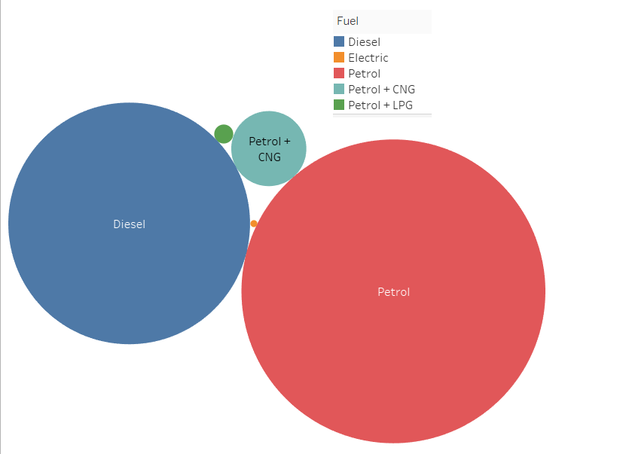
Fuel

Slide 5
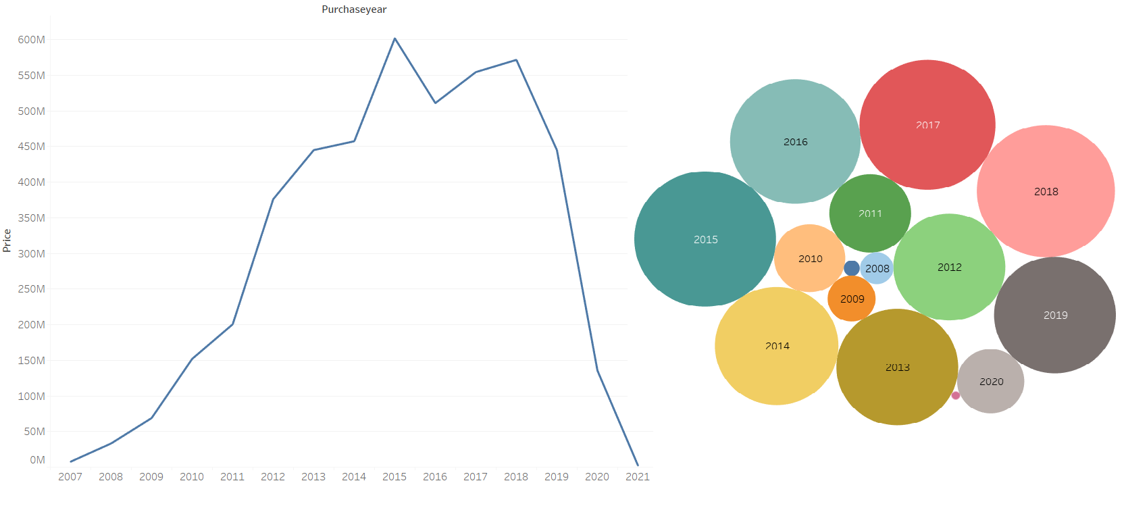
Purchase Year& Price

Slide 6
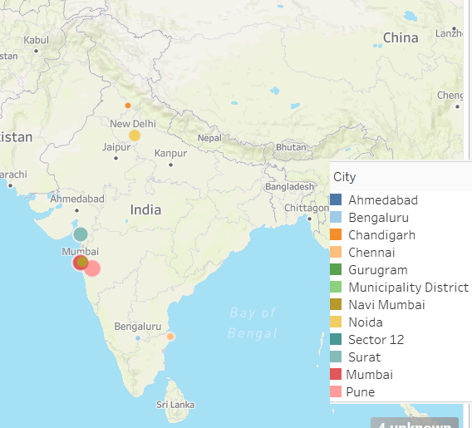
Locations

Slide 7
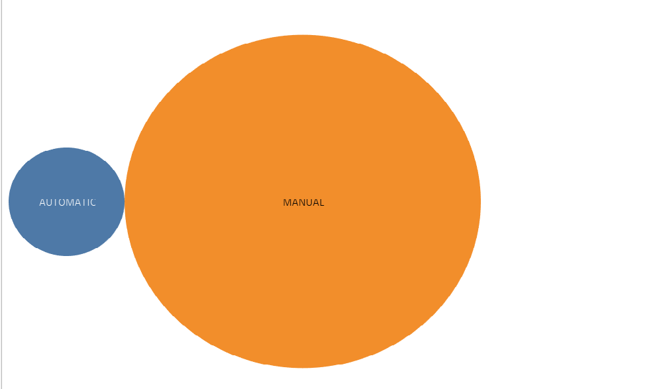
Transmission

Slide 8
INTRODUCTION
Business Problem Framing
With Covid-19 , the earlier ML models are not working. So they have to be re-created based on the current data
Conceptual Background of the Domain Problem
Understanding cities, types of car and fuel used will be helpful. Also the age of the car is very critical
Motivation for the Problem Undertaken
It is live data and the first time working on live data is very challenging and exciting.

Slide 9
Data Sources and their formats
Used live websites to scrape data. Collected close to 10k data from cars24. Also collected 5k from other sites (OLX, Carwale, Carsandbikes). Decided to go with the Cars24 data, as there were duplicates in other data.
Data Preprocessing Done
Pre-Processing was done using Excel and Python. Excel to merge the several excel sheets, remove missing value, and clean the data. Python was used to remove the columns that are not needed, remove duplicates.
Data Inputs- Logic- Output Relationships
Price is affected by the age, brand, kms driven.
Hardware and Software Requirements and Tools Used
Python-Numpy, Pandas, Graphical support, Machine Learning. Excle, Tableau. Webscrapping-Selenium

